Slide 1
Chapter 1. Introduction to Data Analysis with Spark
Apache Spark is a cluster computing platform designed to be fast and general-purpose
On the speed side, Spark extends the popular MapReduce model to efficiently support more types of computations, including interactive queries and stream processing.
One of the main features Spark offers for speed is the ability to run computations in memory, but the system is also more efficient than MapReduce for complex applications running on disk.

Slide 2
On the generality side, Spark is designed to cover a wide range of workloads that previously required separate distributed systems, including batch applications, iterative algorithms, interactive queries, and streaming.
By supporting these workloads in the same engine, Spark makes it easy and inexpensive to combine different processing types, which is often necessary in production data analysis pipelines.
In addition, it reduces the management burden of maintaining separate tools.

Slide 3
A Unified Stack
The Spark project contains multiple closely integrated components.
At its core, Spark is a “computational engine” that is responsible for scheduling, distributing, and monitoring applications consisting of many computational tasks across many worker machines, or a computing cluster.
A philosophy of tight integration has several benefits.
First, all libraries and higher-level components in the stack benefit from improvements at the lower layers.
For example, when Spark’s core engine adds an optimization, SQL and machine learning libraries automatically speed up as well.

Slide 4
Second, the costs associated with running the stack are minimized, because instead of running 5–10 independent software systems, an organization needs to run only one.
These costs include deployment, maintenance, testing, support, and others
Finally, one of the largest advantages of tight integration is the ability to build applications that seamlessly combine different processing models.
For example, in Spark you can write one application that uses machine learning to classify data in real time as it is ingested from streaming sources.
Simultaneously, analysts can query the resulting data, also in real time, via SQL

Slide 5
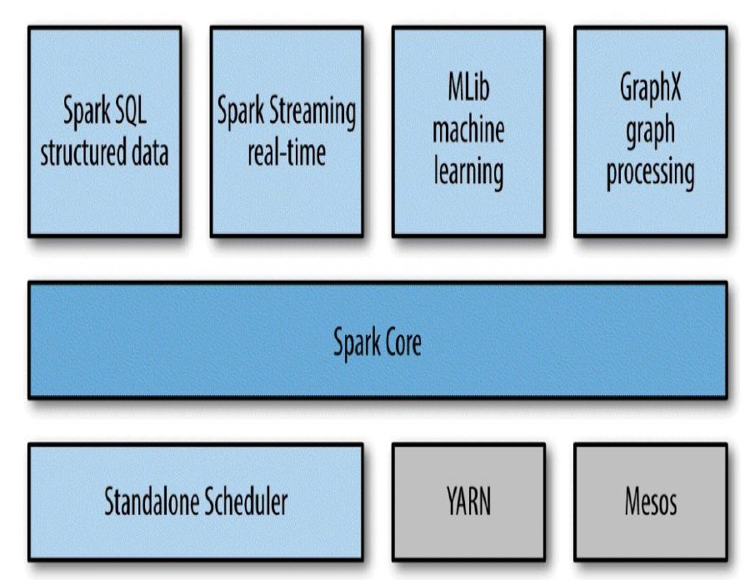
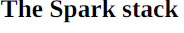

Slide 6
Spark Core
Spark Core contains the basic functionality of Spark, including components for task scheduling, memory management, fault recovery, interacting with storage systems, and more.
Spark Core is also home to the API that defines resilient distributed datasets (RDDs), which are Spark’s main programming abstraction.

Slide 7
Spark SQL
Spark SQL is Spark’s package for working with structured data.
It allows querying data via SQL as well as the Hive Query Language (HQL) — and it supports many sources of data, including Hive tables, Parquet, and JSON.
Beyond providing a SQL interface to Spark, Spark SQL allows developers to intermix SQL queries with the programmatic data manipulations supported by RDDs in Python, Java, and Scala, all within a single application, thus combining SQL with complex analytic

Slide 8
Spark Streaming
Spark Streaming is a Spark component that enables processing of live streams of data.
Examples of data streams include
logfiles generated by production web servers, or
queues of messages containing status updates posted by users of a web service.
Spark Streaming provides an API for manipulating data streams that closely matches the Spark Core’s RDD API that manipulate data stored in memory, on disk, or arriving in real time.

Slide 9
Mllib
Spark comes with a library containing common machine learning (ML) functionality, called MLlib.
MLlib provides multiple types of machine learning algorithms, including classification, regression, clustering, and collaborative filtering, as well as supporting functionality such as model evaluation and data import

Slide 10
GraphX
GraphX is a library for manipulating graphs (e.g., a social network’s friend graph) and performing graph-parallel computations.
GraphX extends the Spark RDD API, allowing us to create a directed graph with arbitrary properties attached to each vertex and edge.
GraphX also provides various operators for manipulating graphs (e.g., subgraph and mapVertices) and a library of common graph algorithms

Slide 11
Cluster Managers
Spark is designed to efficiently scale up from one to many thousands of compute nodes.
To achieve this while maximizing flexibility, Spark can run over a variety of cluster managers, including Hadoop YARN, Apache Mesos, and a simple cluster manager included in Spark itself called the Standalone Scheduler

Slide 12
Who Uses Spark, and for What?
Outlined two groups of readers - Data scientists and Engineers
Data Science Tasks
A data scientist is somebody whose main task is to analyze and model data.
Data scientists may have experience with SQL, statistics, predictive modeling (machine learning), and programming
Data scientists use their skills to analyze data with the goal of answering a question or discovering insights.

Slide 13
Oftentimes, their workflow involves ad hoc analysis, so they use interactive shells. Machine learning and data analysis is supported through the MLLib libraries.
Sometimes, after the initial exploration phase, the work of a data scientist will be productized or extended and tuned to become a production data processing application, which itself is a component of a business application.
Often it is a different person or team that leads the process of productizing the work of the data scientists, and that person is often an engineer.

Slide 14
Data Processing Applications
The other main use case of Spark can be described in the context of the engineer persona.
Engineers are large class of software developers who use Spark to build production data processing applications.
For engineers, Spark provides a simple way to parallelize these applications across clusters, and hides the complexity of distributed systems programming, network communication, and fault tolerance.
The system gives them enough control to monitor, inspect, and tune applications while allowing them to implement common tasks quickly.

Slide 15
Storage Layers for Spark
Spark can create distributed datasets from any file stored in the Hadoop distributed filesystem (HDFS) or other storage systems supported by the Hadoop APIs (including your local filesystem, Amazon S3, Cassandra, Hive, HBase, etc.).
It’s important to remember that Spark does not require Hadoop;
It simply has support for storage systems implementing the Hadoop APIs.
Spark supports text files, SequenceFiles, Avro, Parquet, and any other Hadoop InputFormat.

Slide 16
Compare Hadoop and Spark
Feature Criteria | Apache Spark | Hadoop
Speed | 100 times faster than Hadoop | Decent speed
Processing | Real-time & Batch processing | Batch processing only
Difficulty | Easy because of high level modules | Tough to learn
Recovery | Allows recovery of partitions | Fault-tolerant
Interactivity | Has interactive modes | No interactive mode except Pig & Hive

Slide 17
Introduction to Spark’s Python and Scala Shells
Spark comes with interactive shells that enable ad hoc data analysis.
Unlike most other shells, however, which let you manipulate data using the disk and memory on a single machine, Spark’s shells allow you to interact with data that is distributed on disk or in memory across many machines
Spark takes care of automatically distributing this processing.
Because Spark can load data into memory on the worker nodes, many distributed computations can run in a few seconds
Spark provides both Python and Scala Shells

Slide 18
The easiest way to demonstrate the power of Spark’s shells is to start using one of them for some simple data analysis
The first step is to open up one of Spark’s shell
To open the Python version of the Spark shell, which we also refer to as the PySpark Shell, go into your Spark directory and type: bin/pyspark
To open the Scala version of the shell, typebin/spark-shell
In Spark, we express our computation through operations on distributed collections that are automatically parallelized across the cluster.
These collections are called resilient distributed datasets, or RDDs.

Slide 19
In Spark, we express our computation through operations on distributed collections that are automatically parallelized across the cluster.
These collections are called resilient distributed datasets, or RDDs.
Example- Python line count
>>> lines = sc.textFile(“README.md”) # Create an RDD called lines
>>> lines.count() # Count the number of items in this RDD
127
>>> lines.first() # First item in this RDD, i.e. first line of README.md

Slide 20
Example - Scala line count
scala> val lines = sc.textFile(“README.md”) // Create an RDD called lines
lines: spark.RDD[String] = MappedRDD[…]
scala> lines.count() // Count the number of items in this RDD
res0: Long = 127
scala> lines.first() // First item in this RDD, i.e. first line of README.md
res1: String = # Apache Spark
At a high level, every Spark application consists of a driver program that launches various parallel operations on a cluster.
The driver program contains your application’s main function and defines distributed datasets on the cluster, then applies operations to them.
In the preceding examples, the driver program was the Spark shell itself, and you could just type in the operations you wanted to run.

Slide 21
Driver programs access Spark through a object, which represents a SparkContext connection to a computing cluster.
In the shell, a SparkContext is automatically created for you as the variable called sc.
Once you have a SparkContext, you can use it to build RDDs.
In Examples 2-1 and 2-2,
we called sc.textFile() to create an RDD representing the lines of text in a file.
We can then run various operations on these lines, such as count().
To run these operations, driver programs typically manage a number of nodes called
executors. For example, if we were running the count() operation on a cluster, different
machines might count lines in different ranges of the file.

Slide 22
Finally, a lot of Spark’s API revolves around passing functions to its operators to run them on the cluster.
For example, we could extend our README example by filtering the lines in the file that contain a word, such as Python, as shown in Example 2-4 (for Python) and Example 2-5 (for Scala).
Example 2-4. Python filtering example
>>> lines = sc.textFile(“README.md”)
>>> pythonLines = lines.filter(lambda line: “Python” in line)
>>> pythonLines.first()
u’## Interactive Python Shell’
Example 2-5. Scala filtering example
scala> val lines = sc.textFile(“README.md”) // Create an RDD called lines
lines: spark.RDD[String] = MappedRDD[…]
scala> val pythonLines = lines.filter(line => line.contains(“Python”))
pythonLines: spark.RDD[String] = FilteredRDD[…]
scala> pythonLines.first()

Slide 23
Programming with RDDs
This chapter introduces Spark’s core abstraction for working with data, the resilient distributed dataset (RDD).
An RDD is simply a distributed collection of elements.
In Spark all work is expressed as either creating new RDDs, transforming existing RDDs, or calling operations on RDDs to compute a result.
Under the hood, Spark automatically distributes the data contained in RDDs across your cluster and parallelizes the operations you perform on them.

Slide 24
RDD Basics
An RDD in Spark is simply an immutable distributed collection of objects.
Each RDD is split into multiple partitions, which may be computed on different nodes of the cluster.
RDDs can contain any type of Python, Java, or Scala objects, including user-defined classes
Users create RDDs in two ways:
🡪by loading an external dataset, OR
🡪 by distributing a collection of objects (e.g., a list or set) in their driver program
Creating an RDD of strings with textFile() in Python
>>> lines = sc.textFile(“README.md”)

Slide 25
Once created, RDDs offer two types of operations: transformations and actions.
Transformations construct a new RDD from a previous one. For example, one common transformation is filtering data that matches a predicate
Calling the filter() transformation
>>> pythonLines = lines.filter(lambda line: “Python” in line)
Actions, on the other hand, compute a result based on an RDD, and either return it to the driver program or save it to an external storage system (e.g., HDFS).
One example of an action is first(), which returns the first element in an RDD

Slide 26
Calling the first() action
>>> pythonLines.first()
Transformations and actions are different because of the way Spark computes RDDs.
Although you can define new RDDs any time, Spark computes them only in a lazy fashion — that is, the first time they are used in an action

Slide 27
Finally, Spark’s RDDs are by default recomputed each time you run an action on them.
If you would like to reuse an RDD in multiple actions, you can ask Spark to persist it using RDD.persist().
Persisting an RDD in memory
>>> pythonLines.persist
>>> pythonLines.count()
2
>>> pythonLines.first()

Slide 28
To summarize, every Spark program and shell session will work as follows:
Create some input RDDs from external data.
2. Transform them to define new RDDs using transformations like filter().
3. Ask Spark to persist() any intermediate RDDs that will need to be reused.
4. Launch actions such as count() and first() to kick off a parallel computation, which is then optimized and executed by Spark.

Slide 29
Creating RDDs
Spark provides two ways to create RDDs: loading an external dataset and parallelizing a collection in your driver program.
The simplest way to create RDDs is to take an existing collection in your program and pass it to SparkContext’s parallelize() method, as shown

Slide 30
Example 3-5. parallelize() method in Python
lines = sc.parallelize([“pandas”, “i like pandas”])
Example 3-6. parallelize() method in Scala
val lines = sc.parallelize(List(“pandas”, “i like pandas”))
Example 3-7. parallelize() method in Java
JavaRDD<String> lines = sc.parallelize(Arrays.asList(“pandas”, “i like pandas”));

Slide 31
A more common way to create RDDs is to load data from external storage.
One method that loads a text file as an RDD of strings, SparkContext.textFile(), which is shown
Example 3-8. textFile() method in Python
lines = sc.textFile(“/path/to/README.md”)
Example 3-9. textFile() method in Scala
val lines = c.textFile(“/path/to/README.md”)
Example 3-10. textFile() method in Java
JavaRDD<String> lines = sc.textFile(“/path/to/README.md”);

Slide 32
RDD Operations
As we’ve discussed, RDDs support two types of operations: transformations and actions.
Transformations are operations on RDDs that return a new RDD, such as map() and filter().
Actions are operations that return a result to the driver program or write it to storage, and kick off a computation, such as count() and first().
Spark treats transformations and actions very differently, so understanding which type of operation you are performing will be important.
If you are ever confused whether a given function is a transformation or an action, you can look at its return type: transformations return RDDs, whereas actions return some other data type.

Slide 33
Transformations
Transformations are operations on RDDs that return a new RDD.
Transformed RDDs are computed lazily, only when you use them in an action
As an example, suppose that we have a logfile, log.txt, with a number of messages, and we
want to select only the error messages. We can use the filter() transformation
Example 3-11. filter() transformation in Python
inputRDD = sc.textFile(“log.txt”)
errorsRDD = inputRDD.filter(lambda x: “error” in x)
Example 3-12. filter() transformation in Scala
val inputRDD = sc.textFile(“log.txt”)
val errorsRDD = inputRDD.filter(line => line.contains(“error”))
Example 3-13. filter() transformation in Java
JavaRDD<String> inputRDD = sc.textFile(“log.txt”);
JavaRDD<String> errorsRDD = inputRDD.filter(
new Function<String, Boolean>() {
public Boolean call(String x) { return x.contains(“error”); }

Slide 34
Note that the filter() operation does not mutate the existing inputRDD.
Instead, it returns a pointer to an entirely new RDD. inputRDD can still be reused later in the program — for instance, to search for other words.
Let’s use inputRDD again to search for lines with the word warning in them.
Then, we’ll use another transformation, union(), to print out the number of lines that contained either error or warning
Example 3-14. union() transformation in Python
errorsRDD = inputRDD.filter(lambda x: “error” in x)
warningsRDD = inputRDD.filter(lambda x: “warning” in x)
badLinesRDD = errorsRDD.union(warningsRDD)

Slide 35
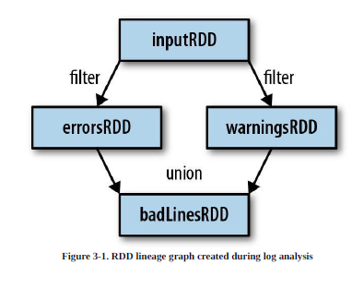
Finally, as you derive new RDDs from each other using transformations, Spark keeps track of the set of dependencies between different RDDs, called the lineage graph.
It uses this information to compute each RDD on demand and to recover lost data if part of a persistent RDD is lost

Slide 36
Actions
We’ve seen how to create RDDs from each other with transformations, but at some point, we’ll want to actually do something with our dataset.
Actions are the second type of RDD operation.
They are the operations that return a final value to the driver program or write data to an external storage system.
Actions force the evaluation of the transformations required for the RDD they were called on, since they need to actually produce output.
For example, we might want to print out some information about the badLinesRDD. To do that, we’ll use two actions, count(), which returns the count as a number, and take(), which collects a number of elements from the RDD, as shown

Slide 37
Example 3-15. Python error count using actions
print “Input had “ + badLinesRDD.count() + ” concerning lines”
print “Here are 10 examples:”
for line in badLinesRDD.take(10):
print line
Example 3-16. Scala error count using actions
println(“Input had “ + badLinesRDD.count() + ” concerning lines”)
println(“Here are 10 examples:”)
badLinesRDD.take(10).foreach(println)
Example 3-17. Java error count using actions
System.out.println(“Input had “ + badLinesRDD.count() + ” concerning lines”)
System.out.println(“Here are 10 examples:”)
for (String line: badLinesRDD.take(10)) {
System.out.println(line);
}
In this example, we used take() to retrieve a small number of elements in the RDD at the driver program
We then iterate over them locally to print out information at the driver.

Slide 38
Lazy Evaluation
transformations on RDDs are lazily evaluated, meaning that Spark will not begin to execute until it sees an action.
Lazy evaluation means that when we call a transformation on an RDD (for instance, calling map()), the operation is not immediately performed.
Instead, Spark internally records metadata to indicate that this operation has been requested.
Rather than thinking of an RDD as containing specific data, it is best to think of each RDD as consisting of instructions on how to compute the data that we build up through transformations.
Loading data into an RDD is lazily evaluated in the same way transformations are. So, when we call sc.textFile(), the data is not loaded until it is necessary

Slide 39
Passing Functions to Spark
Most of Spark’s transformations, and some of its actions, depend on passing in functions that are used by Spark to compute data
Passing functions in Python
word = rdd.filter(lambda s: “error” in s)
def containsError(s):
return “error” in s
word = rdd.filter(containsError)

Slide 40
Scala function passing
class SearchFunctions(val query: String) {
def isMatch(s: String): Boolean = {
s.contains(query)
}
def getMatchesFunctionReference(rdd: RDD[String]): RDD[String] = {
rdd.map(isMatch)

Slide 41
Function name Method to implement Usage
Function<T, R> R call(T)
Take in one input and return one output, for use with operations like map() and filter().
Function2<T1, T2,R> R call(T1, T2)
Take in two inputs and return one output, for use with operations like
aggregate() or fold().
FlatMapFunction<T,R> Iterable<R> call(T)
Take in one input and return zero or more outputs, for use with operations like flatMap().

Slide 42
Common Transformations and Actions
Element-wise transformations
The two most common transformations you will likely be using are map() and filter()
The map() transformation takes in a function and applies it to each element in the RDD with the result of the function being the new value of each element in the resulting RDD.
The filter() transformation takes in a function and returns an RDD that only has elements that pass the filter() function

Slide 43
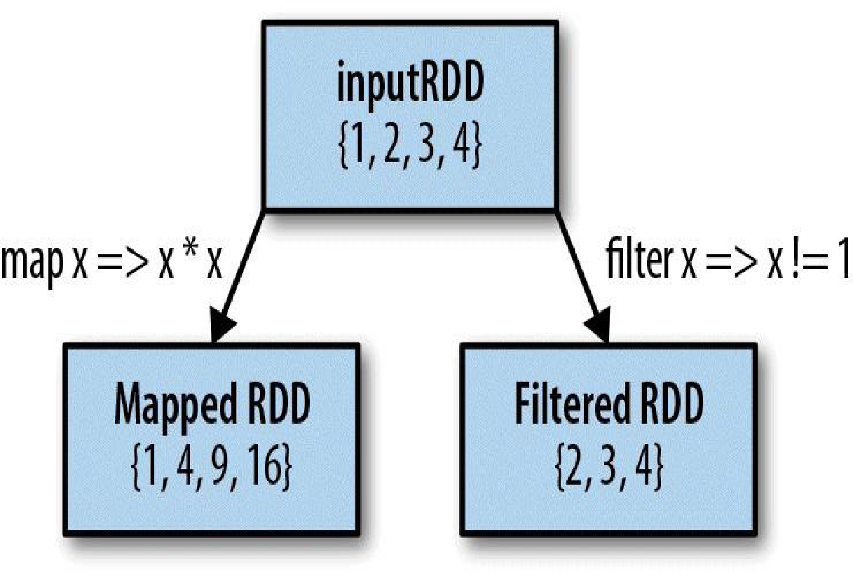

Slide 44
Example 3-26. Python squaring the values in an RDD
nums = sc.parallelize([1, 2, 3, 4])
squared = nums.map(lambda x: x * x).collect()
for num in squared:
print “%i “ % (num)
Example 3-27. Scala squaring the values in an RDD
val input = sc.parallelize(List(1, 2, 3, 4))
val result = input.map(x => x * x)
println(result.collect().mkString(“,”))
Example 3-28. Java squaring the values in an RDD
JavaRDD<Integer> rdd = sc.parallelize(Arrays.asList(1, 2, 3, 4));
JavaRDD<Integer> result = rdd.map(new Function<Integer, Integer>() {
public Integer call(Integer x) { return x*x; }
});
System.out.println(StringUtils.join(result.collect(), “,”));

Slide 45
Sometimes we want to produce multiple output elements for each input element.
The operation to do this is called flatMap(). As with map(), the function we provide to flatMap() is called individually for each element in our input RDD.
Instead of returning a single element, we return an iterator with our return values.
Rather than producing an RDD of iterators, we get back an RDD that consists of the elements from all of the iterators

Slide 46
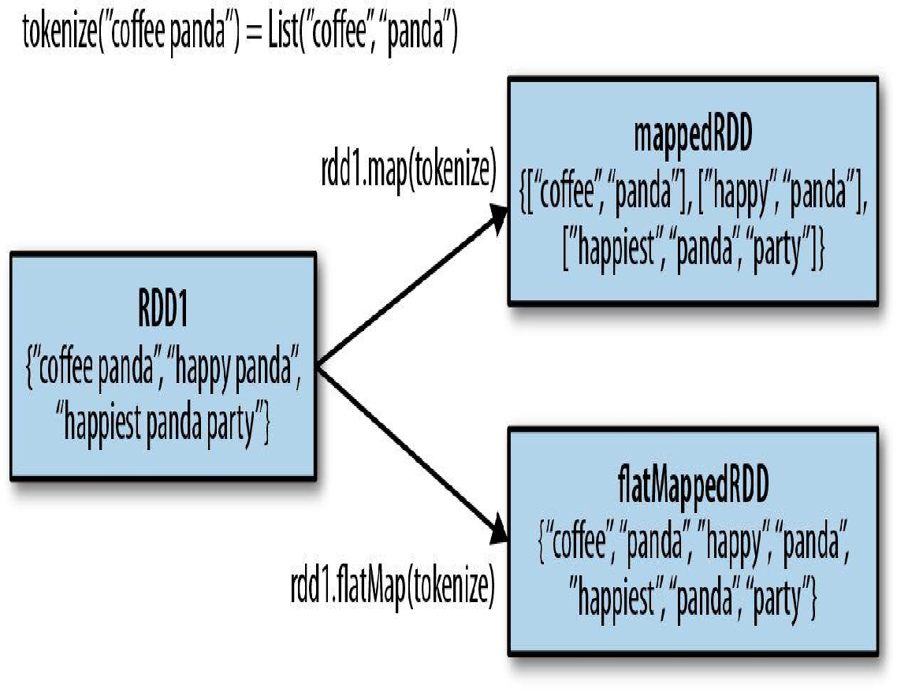

Slide 47
Example 3-29. flatMap() in Python, splitting lines into words
lines = sc.parallelize([“hello world”, “hi”])
words = lines.flatMap(lambda line: line.split(” “))
words.first() # returns “hello”
Example 3-30. flatMap() in Scala, splitting lines into multiple words
val lines = sc.parallelize(List(“hello world”, “hi”))
val words = lines.flatMap(line => line.split(” “))
words.first() // returns “hello”
Example 3-31. flatMap() in Java, splitting lines into multiple words
JavaRDD<String> lines = sc.parallelize(Arrays.asList(“hello world”, “hi”));
JavaRDD<String> words = lines.flatMap(new FlatMapFunction<String, String>() {
public Iterable<String> call(String line) {
return Arrays.asList(line.split(” “));
}
});
words.first();

Slide 48
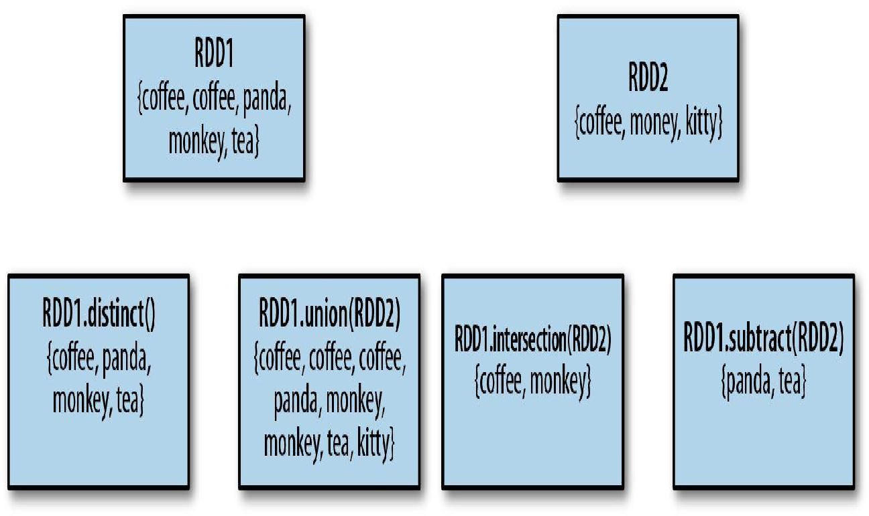
Pseudo set operations

Slide 49
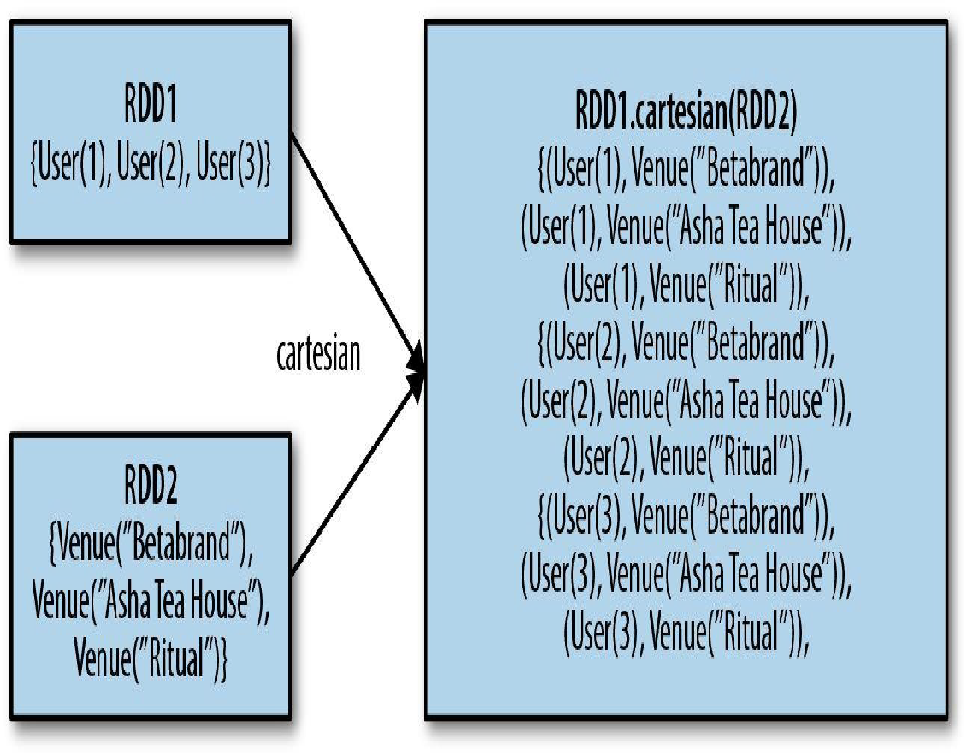

Slide 50
Basic RDD transformations on an RDD containing {1, 2, 3, 3}
map()
Apply a function to each element in the RDD and
return an RDD of the result.
rdd.map(x => x + 1) {2, 3, 4, 4}
flatMap()
Apply a function to each element in the RDD and
return an RDD of the contents of the iterators
returned. Often used to extract words.
rdd.flatMap(x => x.to(3)) {1, 2, 3, 2, 3, 3, 3}
filter()
Return an RDD consisting of only elements that
pass the condition passed to filter().
rdd.filter(x => x != 1) {2, 3, 3}
distinct()
Remove duplicates.
rdd.distinct() {1, 2, 3}

Slide 51
Two-RDD transformations on RDDs containing {1, 2, 3} and {3, 4, 5}
Function name Purpose Example Result
union()- Produce an RDD containing elements from both RDDs.
rdd.union(other)
{1, 2, 3, 3, 4, 5}
intersection() - RDD containing only elements found in both RDDs.
rdd.intersection(other) {3}
subtract() -Remove the contents of one RDD (e.g., remove training data).
rdd.subtract(other) {1, 2}
cartesian() -Cartesian product with the other RDD.
rdd.cartesian(other)
{(1, 3), (1, 4), … (3,5)}

Slide 52
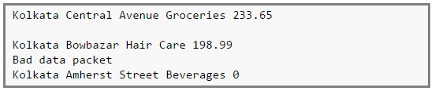
What are accumulators?
Accumulators are variables that are used for aggregating information across the executors
For example, this information can pertain to data or API diagnosis like how many records are corrupted or how many times a particular library API was called.
To understand why we need accumulators, let’s see a small example.

Slide 53
There are 4 fields,
Field 1 -> City
Field 2 -> Locality
Field 3 -> Category of item sold
Field 4 -> Value of item sold
However, the logs can be corrupted. For example, the second line is a blank line, the fourth line reports some network issues and finally the last line shows a sales value of zero (which cannot happen!).

Slide 54
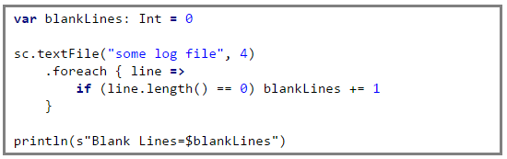
We can use accumulators to analyse the transaction log to find out the number of blank logs (blank lines), number of times the network failed, any product that does not have a category or even number of times zero sales were recorded.
The problem with the above code is that when the driver prints the variable blankLines its value will be zero.
This is because when Spark ships this code to every executor the variables become local to that executor and its updated value is not relayed back to the driver.
To avoid this problem we need to make blankLines an accumulator such that all the updates to this variable in every executor is relayed back to the driver.
So the above code should be written as,

Slide 55
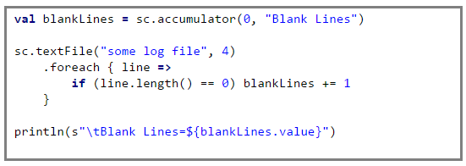
This guarantees that the accumulator blankLines is updated across every executor and the updates are relayed back to the driver.

Slide 56
Actions
The most common action on basic RDDs you will likely use is reduce(), which takes a function that operates on two elements of the type in your RDD and returns a new element of the same type
Example 3-32. reduce() in Python
sum = rdd.reduce(lambda x, y: x + y)
Example 3-33. reduce() in Scala
val sum = rdd.reduce((x, y) => x + y)
Example 3-34. reduce() in Java
Integer sum = rdd.reduce(new Function2<Integer, Integer, Integer>() {
public Integer call(Integer x, Integer y) { return x + y; } });

Slide 57
Reducebykey()
val data = Seq(("Project", 1),
("Gutenberg’s", 1),
("Alice’s", 1),
("Adventures", 1),
("in", 1),
("Wonderland", 1),
("Project", 1),
("Gutenberg’s", 1),
("Adventures", 1),
("in", 1),
("Wonderland", 1),
("Project", 1),
("Gutenberg’s", 1))
val rdd=spark.sparkContext.parallelize(data)
As you see the data here, it’s in key/value pair.
Key is the work name and value is the count.

Slide 58
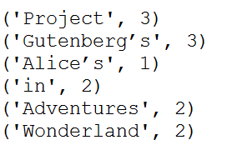
Below is the syntax of the Spark RDD reduceByKey() transformation
val rdd2=rdd.reduceByKey(_ + _)
rdd2.foreach(println)

Slide 59
Similar to reduce() is fold(), which also takes a function with the same signature as needed for reduce(), but in addition takes a “zero value” to be used for the initial call on each partition.
The zero value you provide should be the identity element for your operation; that is, applying it multiple times with your function should not change the value (e.g., 0 for +, 1 for *, or an empty list for concatenation).

Slide 60
Fold in spark
def fold[T](acc:T)((acc,value) => acc)
T is the data type of RDD
acc is accumulator of type T which will be return value of the fold operation
A function , which will be called for each element in rdd with previous accumulator.

Slide 61
Finding max in a given RDD
Let’s first build a RDD
val employeeData = List(("Jack",1000.0),("Bob",2000.0),("Carl",7000.0))
val employeeRDD = sparkContext.makeRDD(employeeData)
Now we want to find an employee, with maximum salary. We can do that using fold.
To use fold we need a start value. The following code defines a dummy employee as starting accumulator.
val dummyEmployee = ("dummy",0.0);
Now using fold, we can find the employee with maximum salary.
val maxSalaryEmployee = employeeRDD.fold(dummyEmployee)((acc,employee) => {
if(acc._2 < employee._2) employee else acc})
println("employee with maximum salary is"+maxSalaryEmployee)

Slide 62
Both fold() and reduce() require that the return type of our result be the same type as that of the elements in the RDD we are operating over.
This works well for operations like sum, but sometimes we want to return a different type.
The aggregate() function frees us from the constraint of having the return be the same type as the RDD we are working on.
With aggregate(), like fold(), we supply an initial zero value of the type we want to return.
We then supply a function to combine the elements from our RDD with the accumulator.
Finally, we need to supply a second function to merge two accumulators, given that each node accumulates its own results
locally.

Slide 63
RDD aggregate() Syntax
Since RDD’s are partitioned, the aggregate takes full advantage of it by first aggregating elements in each partition and then aggregating results of all partition to get the final result. and the result could be any type than the type of your RDD.
aggregate[U](zeroValue: U)(seqOp: (U, T) ⇒ U, combOp: (U, U) ⇒ U)
This takes the following arguments –
zeroValue – Initial value to be used for each partition in aggregation, this value would be used to initialize the accumulator. we mostly use 0 for integer and Nil for collections.

Slide 64
seqOp – This operator is used to accumulate the results of each partition, and stores the running accumulated result to U,
combOp – This operator is used to combine the results of all partitions U.
val listRdd = spark.sparkContext.parallelize(List(1,2,3,4,5,3,2))
def param0= (accu:Int, v:Int) => accu + v
def param1= (accu1:Int,accu2:Int) => accu1 + accu2
val result = listRdd.aggregate(0)(param0,param1)
println("output 1 =>" + result)
Output= 20

Slide 65
cala> val inputrdd = sc.parallelize( List( (“maths”, 21), (“english”, 22), (“science”, 31) ), )
scala> val result = inputrdd.aggregate(0) ( (acc, value) => (acc + value._2),
/* * This is a combOp for mergining two U’s * (ie 2 Int) */ (acc1, acc2) => (acc1 + acc2) ) result: Int = 75
The result is calculated as follows,
Partition 1 : Sum(all Elements) + (Zero value) Partition 2 : Sum(all Elements) + (Zero value) Partition 3 : Sum(all Elements) + (Zero value) Result = Partition1 + Partition2 + Partition3 +
So we get 21 + 22 + 31 = 75.

Slide 66
We can use aggregate() to compute the average of an RDD, avoiding a map() before the
fold(), as shown in Examples 3-35 through 3-37.
Example 3-35. aggregate() in Python
sumCount = nums.aggregate((0, 0),
(lambda acc, value: (acc[0] + value, acc[1] + 1),
(lambda acc1, acc2: (acc1[0] + acc2[0], acc1[1] + acc2[1]))))
return sumCount[0] / float(sumCount[1])
Example 3-36. aggregate() in Scala
val result = input.aggregate((0, 0))(
(acc, value) => (acc._1 + value, acc._2 + 1),
(acc1, acc2) => (acc1._1 + acc2._1, acc1._2 + acc2._2))
val avg = result._1 / result._2.toDouble

Slide 67
AvgCount initial = new AvgCount(0, 0);
AvgCount result = rdd.aggregate(initial, addAndCount, combine);
System.out.println(result.avg());
Example 3-37. aggregate() in Java
class AvgCount implements Serializable {
public AvgCount(int total, int num) {
this.total = total;
this.num = num;
}
public int total;
public int num;
public double avg() {
return total / (double) num;
}
} Function2<AvgCount, Integer, AvgCount> addAndCount =
new Function2<AvgCount, Integer, AvgCount>() {
public AvgCount call(AvgCount a, Integer x) {
a.total += x;
a.num += 1;
return a;
} };
Function2<AvgCount, AvgCount, AvgCount> combine =
new Function2<AvgCount, AvgCount, AvgCount>() {
public AvgCount call(AvgCount a, AvgCount b) {
a.total += b.total;
a.num += b.num;
return a; } };

Slide 68
collect(), which returns the entire RDD’s contents. collect() is commonly used in unit tests where the entire contents of the RDD are expected to fit in memory, as that makes it easy to compare the value of our RDD with our expected result.
take(n) returns n elements from the RDD and attempts to minimize the number of
partitions it accesses, so it may represent a biased collection.
If there is an ordering defined on our data, we can also extract the top elements from an RDD using top(). top() will use the default ordering on the data, but we can supply our own comparison function to extract the top elements

Slide 69
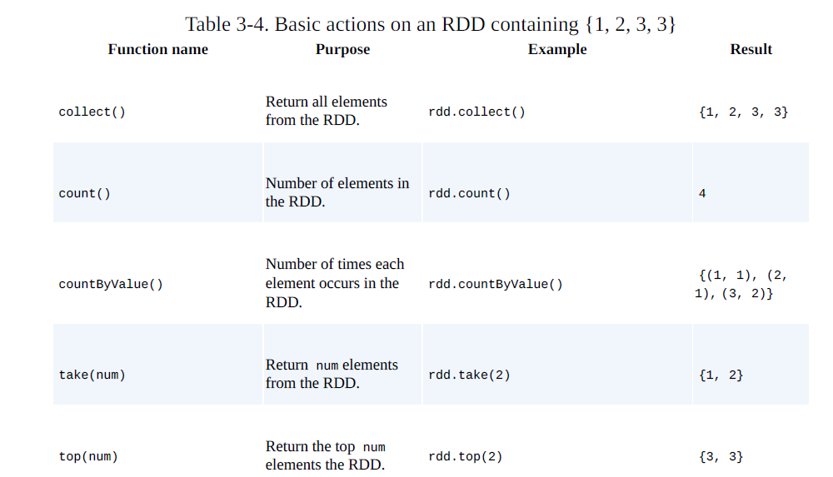

Slide 70
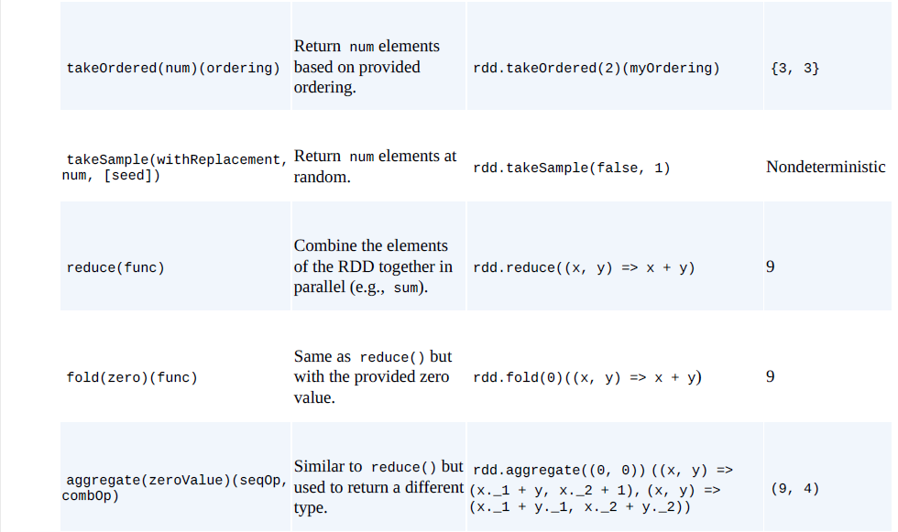

Slide 71
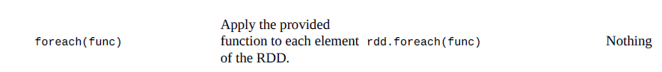

Slide 72
Persistence (Caching)
Spark RDDs are lazily evaluated, and sometimes we may wish to use the same RDD multiple times.
If we do this naively, Spark will recompute the RDD and all of its dependencies each time we call an action on the RDD.
This can be especially expensive for iterative algorithms, which look at the data many times.
Another trivial example would be doing a count and then writing out the same RDD, as shown

Slide 73
val result = input.map(x => x*x)
println(result.count())
println(result.collect().mkString(“,”))
To avoid computing an RDD multiple times, we can ask Spark to persist the data.
When we ask Spark to persist an RDD, the nodes that compute the RDD store their partitions.

Slide 74
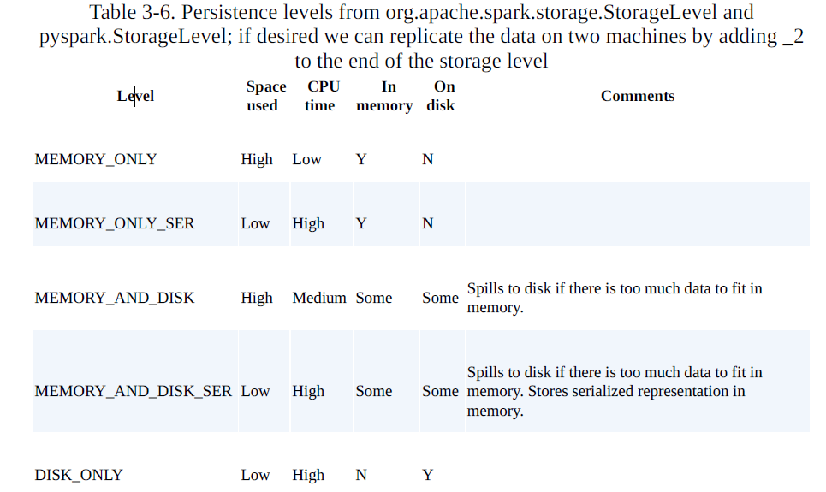

Slide 75
Program to run wordcount on scala shell Note- Create a textfile sparkdata.txt locally and give appropriate path while loading the data using sc.textFile val data=sc.textFile("sparkdata.txt") data.collect; val splitdata = data.flatMap(line => line.split(" ")); splitdata.collect; val mapdata = splitdata.map(word => (word,1)); mapdata.collect; val reducedata = mapdata.reduceByKey(_+_); reducedata.collect;

Slide 76
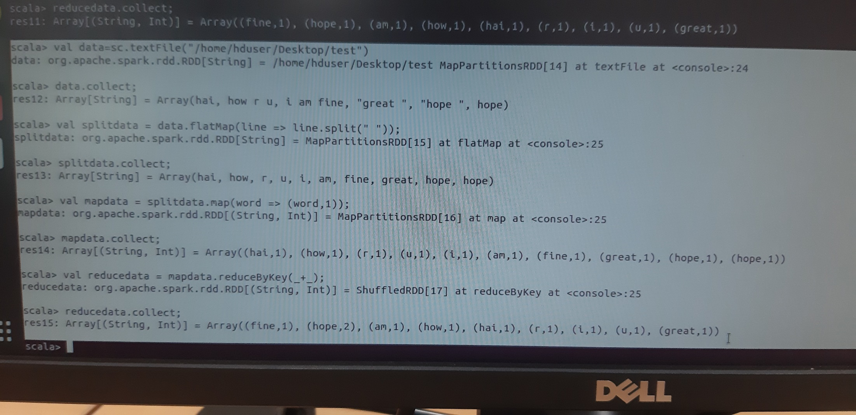

Slide 77
Using RDD and FlaMap count how many times each word appears in a file and write out a list of words whose count is strictly greater than 4 using Spark.
val textFile = sc.textFile("/home/bhoom/Desktop/wc.txt") val counts = textFile.flatMap(line => line.split(" ")).map(word => (word, 1)).reduceByKey(_ + _) import scala.collection.immutable.ListMap val sorted=ListMap(counts.collect.sortWith(_._2 > _._2):_*)// sort in descending order based on values println(sorted) for((k,v)<-sorted) { if(v>4) { print(k+",") print(v) println() } }

Slide 78
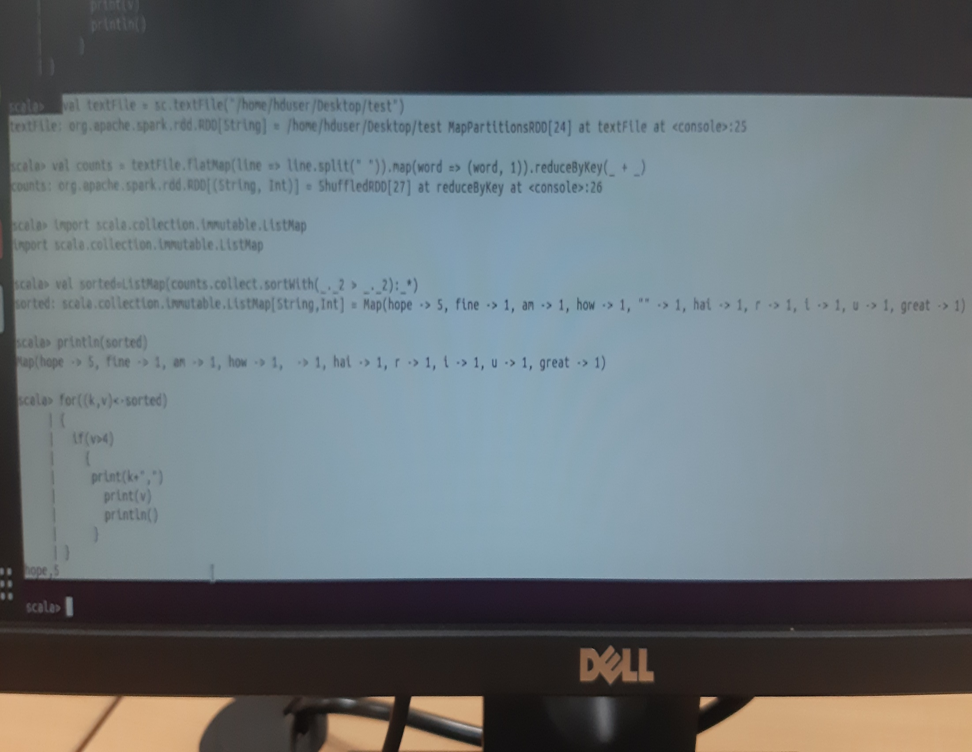

Slide 79
Spark RDD Transformations with Examples
1. val spark:SparkSession = SparkSession.builder()
.master("local[3]")
.appName("SparkByExamples.com")
.getOrCreate()
val sc = spark.sparkContext
val rdd:RDD[String] = sc.textFile("src/main/scala/test.txt")
2. val rdd2 = rdd.flatMap(f=>f.split(" "))

Slide 80
3. val rdd3:RDD[(String,Int)]= rdd2.map(m=>(m,1))
4. val rdd4 = rdd3.filter(a=> a._1.startsWith("a"))
5. val rdd5 = rdd3.reduceByKey(_ + _)
6. SortByKey() transformation is used to sort RDD elements on key.
In our example, first, we convert RDD[(String,Int]) to RDD[(Int,String]) using map transformation and apply sortByKey which ideally does sort on an integer value.
And finally, foreach with println statement prints all words in RDD and their count as key-value pair to console.
val rdd6 = rdd5.map(a=>(a._2,a._1)).sortByKey()
//Print rdd6 result to console
rdd6.foreach(println)

